Slide 1

TERM DEPOSIT PREDICTION USING RANDOM FORESR
By Nuhushan Shareef S
1SG20CS070
Notes:
To use this title animation slide with a new image simply 1) move the top semi-transparent shape to the side, 2) delete placeholder image, 3) click on the picture icon to add a new picture, 4) Move semi-transparent shape back to original position, 5) Update text on slide.

Slide 2
A term deposit, also known as a fixed deposit or time deposit, is a type of financial investment where an individual deposits a sum of money with a financial institution for a specified period of time. The money is invested at a fixed interest rate, and the depositor agrees not to withdraw the funds until the maturity date.

Slide 3
INTRODUCTION
Objective
Prediction of whether the customer has subscribed to a term deposit or not using Random Forest
TERM DEPOSIT PREDICTION USING RANDOM FORESR.
Software used
Anaconda, Jupyter notebook.
Algorithm used
Random Forest
Data Preprocessing Techniques:
Handling nan values using fillna() function.
2. Labelling string values using LabelEncoder()

Slide 4
HOW TO:
Read the csv file using pandas read_csv() function.
Apply different Data preprocessing technique to clean the data.
Divide data set into x and y; x having independents value and y having dependents variables.
Further dividing x and y into x_test, x_train and y_test, y_train respectively using train_test_split().
Importing and applying Random Forest model from sklearn.
Predict the result giving all independent values as input to the model..

Slide 5
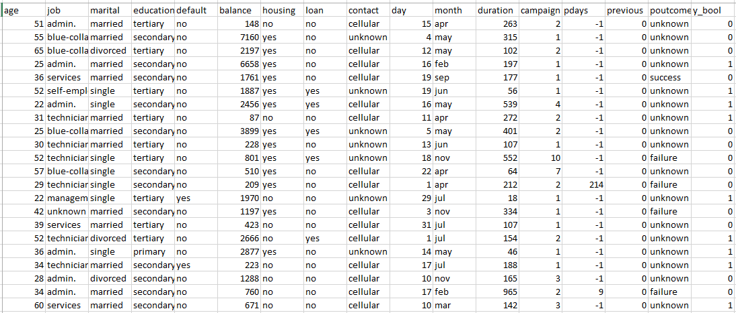
Data Set
Reference : The basics you can find anywhere 5 Steps To Successful Storytelling Published on April 5, 2014 Featured in: Marketing & Advertising

Slide 6
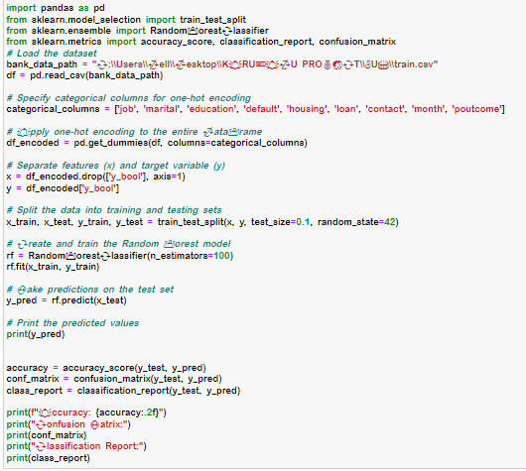
Model Code

Slide 7
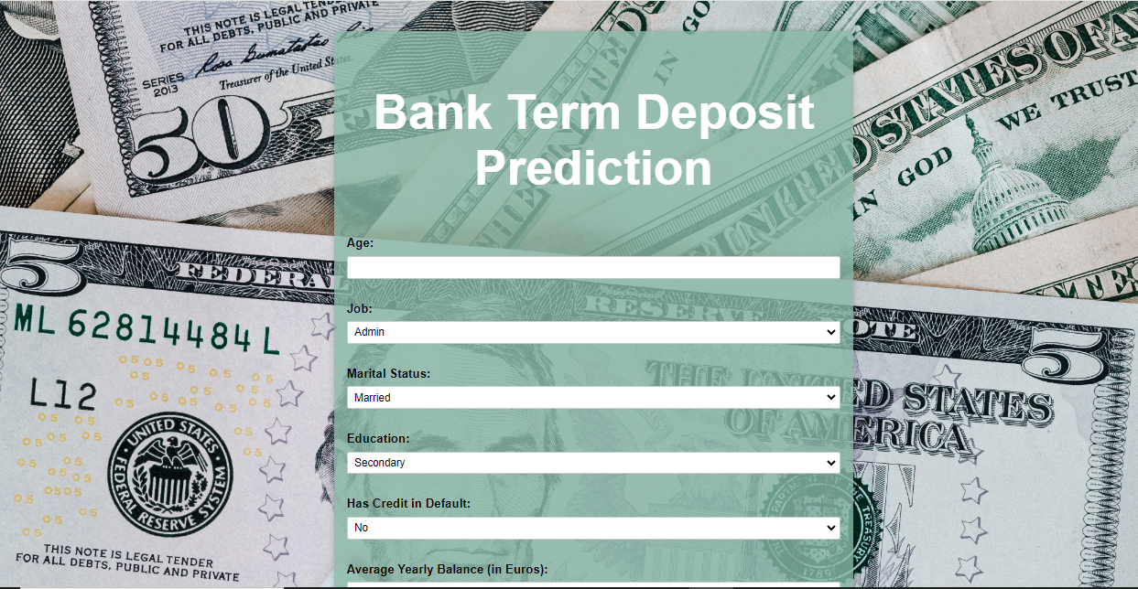
OUTPUT
SUPPORT
We perceive the world through more than our eyes and ears; we smell, we touch, and we taste.
Put your audience in that place and provide them a point of reference; the imagination will do the rest.
Notes:
Tip:
When using complex image as full-bleed background add a transparency (70%-90%) fill layer to give contrast to text.

Slide 8

OUTPUT
SUPPORT
We perceive the world through more than our eyes and ears; we smell, we touch, and we taste.
Put your audience in that place and provide them a point of reference; the imagination will do the rest.
Notes:
Tip:
When using complex image as full-bleed background add a transparency (70%-90%) fill layer to give contrast to text.

Slide 9
THANK YOU

